Slide 1
Trans-Sialidase’s Role in Chronic Chagas Disease, and it’s Potential for Infection Inhibition by Employing Natural Products
National Taiwan University
Hanne Inez Wolff
Aug. 21st, 2013

Slide 2
Research Proposal
Chagas Disease is affecting 10-15 million people world wide, especially in rural areas of Latin America. There are two phases to the disease; the acute phase which lasts about 4-8 weeks, and the chronic phase which follows the acute phase. Currently, there are only two drugs to treat Chagas disease, which are both not approved by the FDA, and to get a hold of the drugs, infected individuals must request them through the CDC and follow strict protocols. More importantly, these two drugs, despite their serious side effects, have shown efficiency only in infected individuals with acute Chagas Disease.
My research is looking at potential Natural Products to treat chronic Chagas Disease via utilizing computational modeling and predictions.

Slide 3
Methodology
Screened and identified “good” PDB structures for docking.
“Good” is defined as experimental and docking overlap
Two docking programs were utilized:
AutoDock 4.0 with plug in
AutoDock Vina
Three Trans-Sialidase structures were identified as good representations in the PDB: 1MS9, 1MS8, 1S0J
Both 1MS9, and 1MS8 are from Buschiazzo (2002) article
1S0J is from Amaya (2004) article

Slide 4
Data Collected from PDB Analysis
 |  |  |  | Experimental Overlap |  | Binding Affinity kcal/mol |  | RMSD Å
PDB ID | Paper | Vina | AD4 | Vina | AD4 | Vina | AD4 | Vina | AD4
1S0J | Amaya (2004) | Y | Y | Y (conf. 1) | Y | -9.9 | -13.55 | 0.000 | 1.367
2AH2 | Amaya (2004) | Y | Y | N | Y | -6.0 | -10.55 | 0.000 | 2.261
1S0I | Amaya (2004) | Y | Y | Y (conf. 1) | N | -8.3 | -9.65 | 0.000 | 4.504
1MR5 | Buschiazzo (2002) | N | N | No Ligand | - | - | - | - | -
1MS8 | Buschiazzo (2002) | Y | Y | Y (conf. 1) | Y | -7.4 | -9.47 | 0.000 | 2.100
1MS5 | Buschiazzo (2002) | Y | N | No Ligand | - | - | - | - | -
1MS9 | Buschiazzo (2002) | Y | Y | Y | Y | -7.8 | -9.84 | 0.000 | 2.707
1MS3 | Buschiazzo (2002) | N | N | No Ligand | - | - | - | - | -
1MS4 | Buschiazzo (2002) | N | N | No Ligand | - | - | - | - | -
1MS0 | Buschiazzo (2002) | N | N | Two Ligands | - | - | - | - | -

Slide 5
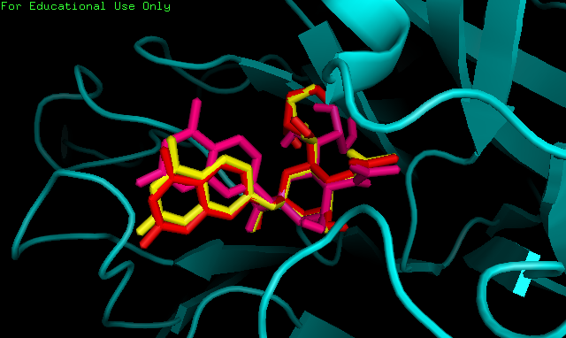
1S0J - Trypanosoma cruzi trans-sialidase in complex with MuNANA (Michaelis complex)
Experimental Ligand crystal (Yellow)
Vina Docking (Red)
AutoDock4.0 Docking (Pink)

Slide 6
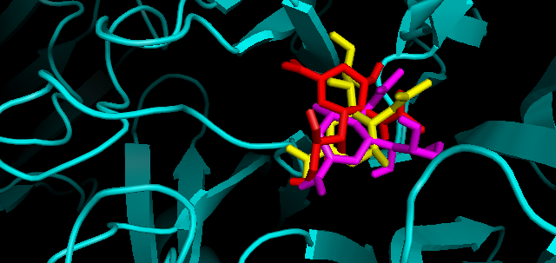
1MS8 - Triclinic form of Trypanosoma cruzi trans-sialidase, in complex with 3-deoxy-2,3-dehydro-N-acetylneuraminic acid (DANA)
Experimental Ligand crystal (Yellow)
Vina Docking (Red)
AutoDock4.0 Docking (Pink)

Slide 7
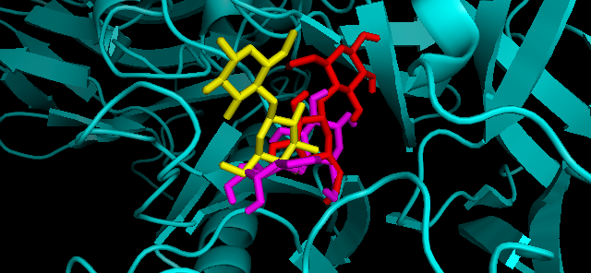
1MS9 - Triclinic form of Trypanosoma cruzi trans-sialidase, in complex with lactose
Experimental Ligand crystal (Yellow)
Vina Docking (Red)
AutoDock4.0 Docking (Pink)

Slide 8
Results – 1S0J
The best structures were used for docking:
Top Ranking binding energies, 1S0J:
-----------------------------------------------------------------------------------------
Rank File Name Binding Affinity kcal/mol
-----------------------------------------------------------------------------------------
1 TPD.71184833541_out.pdbqt -13.6
2 TPD.91185766573_out.pdbqt -12.6
3 TPD.281010096476_out.pdbqt -12.3
4 TPD.281011317462_out.pdbqt -12.3
5 TPD.71184834376_out.pdbqt -12.2
6 TPD.281010461515_out.pdbqt -12.1
7 TPD.91186211040_out.pdbqt -12.1
8 TPD.101185345882_out.pdbqt -12.0
9 TPD.281011318172_out.pdbqt -12.0
10 TPD.281011317061_out.pdbqt -11.8

Slide 9
Results – 1MS8
The best structures were used for docking:
Top Ranking binding energies, 1MS8:
-----------------------------------------------------------------------------------------
Rank File Name Binding Affinity kcal/mol
-----------------------------------------------------------------------------------------
1 TPD.91185766573_out.pdbqt -14.4
2 TPD.281010096476_out.pdbqt -13.8
3 TPD.71184833541_out.pdbqt -12.7
4 TPD.281011409415_out.pdbqt -12.4
5 TPD.281011409716_out.pdbqt -12.4
6 TPD.71184834376_out.pdbqt -12.3
7 TPD.91186211040_out.pdbqt -11.7
8 TPD.281011297903_out.pdbqt -11.6
9 TPD.281011398209_out.pdbqt -11.6
10 TPD.281011399613_out.pdbqt -11.6

Slide 10
Results – 1MS9
The best structures were used for docking:
Top Ranking binding energies, 1MS9:
-----------------------------------------------------------------------------------------
Rank File Name Binding Affinity kcal/mol
-----------------------------------------------------------------------------------------
1 TPD.91185766573_out.pdbqt -14.4
2 TPD.281010096476_out.pdbqt -13.8
3 TPD.71184833541_out.pdbqt -12.7
4 TPD.281011409415_out.pdbqt -12.4
5 TPD.281011409716_out.pdbqt -12.4
6 TPD.71184834376_out.pdbqt -12.3
7 TPD.91186211040_out.pdbqt -11.7
8 TPD.281011297903_out.pdbqt -11.6
9 TPD.281011398209_out.pdbqt -11.6
10 TPD.281011399613_out.pdbqt -11.6

Slide 11
Top 3 Results
Consistently these three compounds are ranked top three across the different trans-sialidase pdb files:
dihalenaquinolide A (CSN: 71184833541)
(+)-Ovigeridimerin (CSN: 91185766573)
Bisisodiospyrin (CSN: 281010096476)

Slide 12
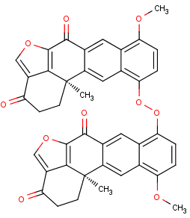
Dihalenaquinolide A
Catalogue number for Taiwanese Pharmaceutical Database, CSN: 71184833541
Vina docking result: -13.6 kcal/mol
AutoDock 4.0 docking result: -15.23 kcal/mol
Agreement between Vina and AutoDock 4.0 alignment

Slide 13
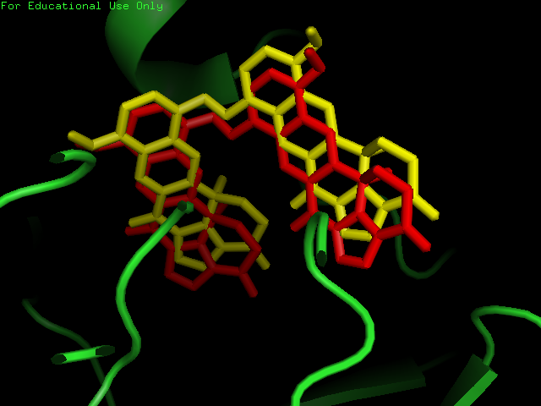
Vina (Yellow)
AutoDock 4.0 (Red)

Slide 14
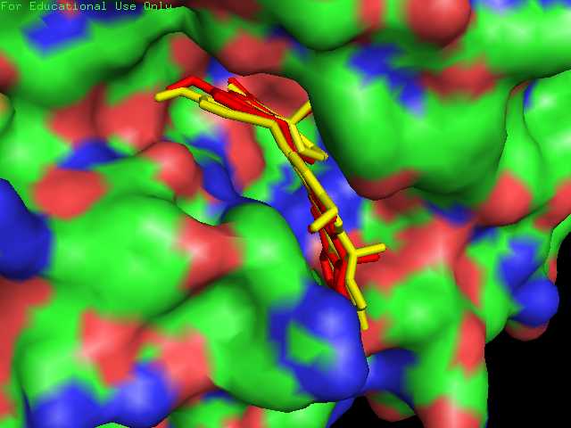
Vina (Yellow)
AutoDock 4.0 (Red)

Slide 15
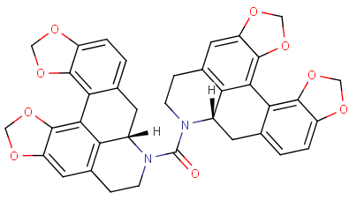
(+)-Ovigeridimerin
Catalogue number for Taiwanese Pharmaceutical Database, CSN: 91185766573
Vina docking result: -12.6 kcal/mol
AutoDock 4.0 docking result: -13.5 kcal/mol

Slide 16
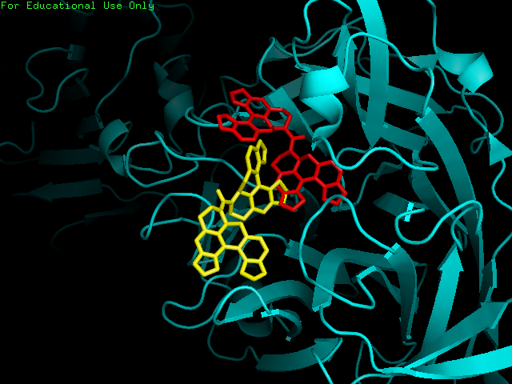
Vina (Yellow)
AutoDock 4.0 (Red)

Slide 17
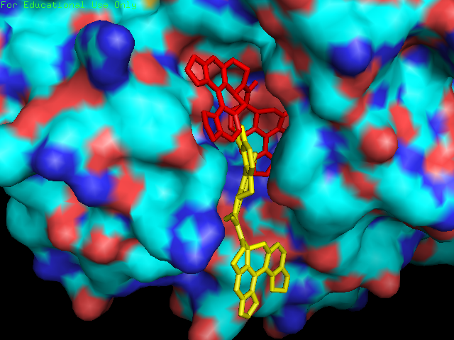
Vina (Yellow)
AutoDock 4.0 (Red)

Slide 18
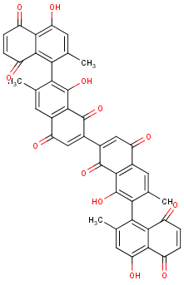
Bisisodiospyrin
Catalogue number for Taiwanese Pharmaceutical Database, CSN: 281010096476
Vina docking result: -12.3 kcal/mol
AutoDock 4.0 docking result: -15.73 kcal/mol

Slide 19
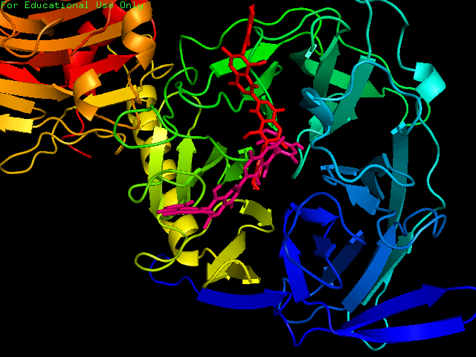
Vina (Red)
AutoDock 4.0 (Pink)

Slide 20
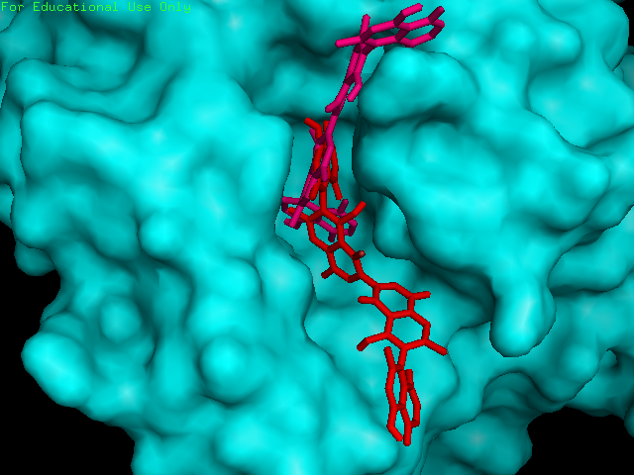
Vina (Red)
AutoDock 4.0 (Pink)

Slide 21
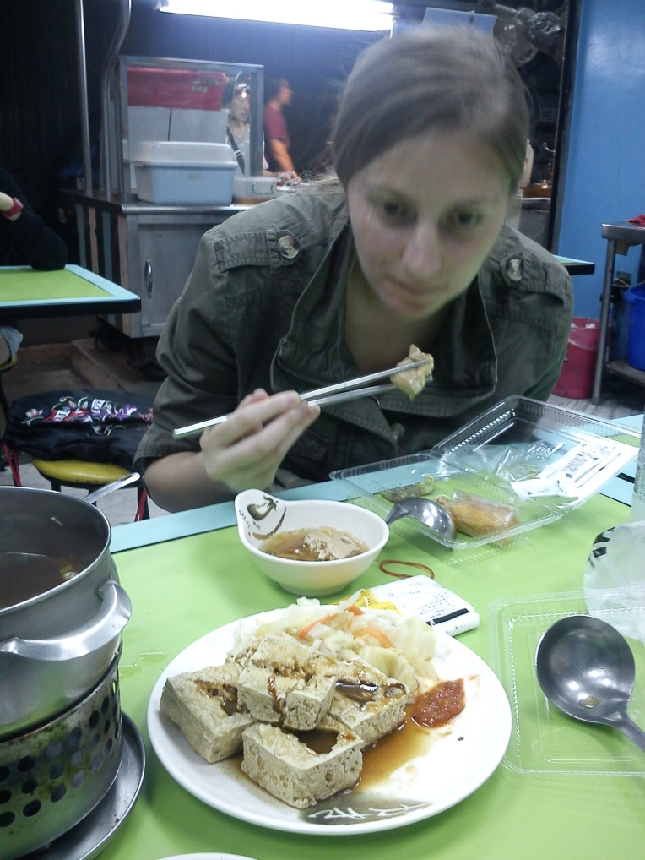
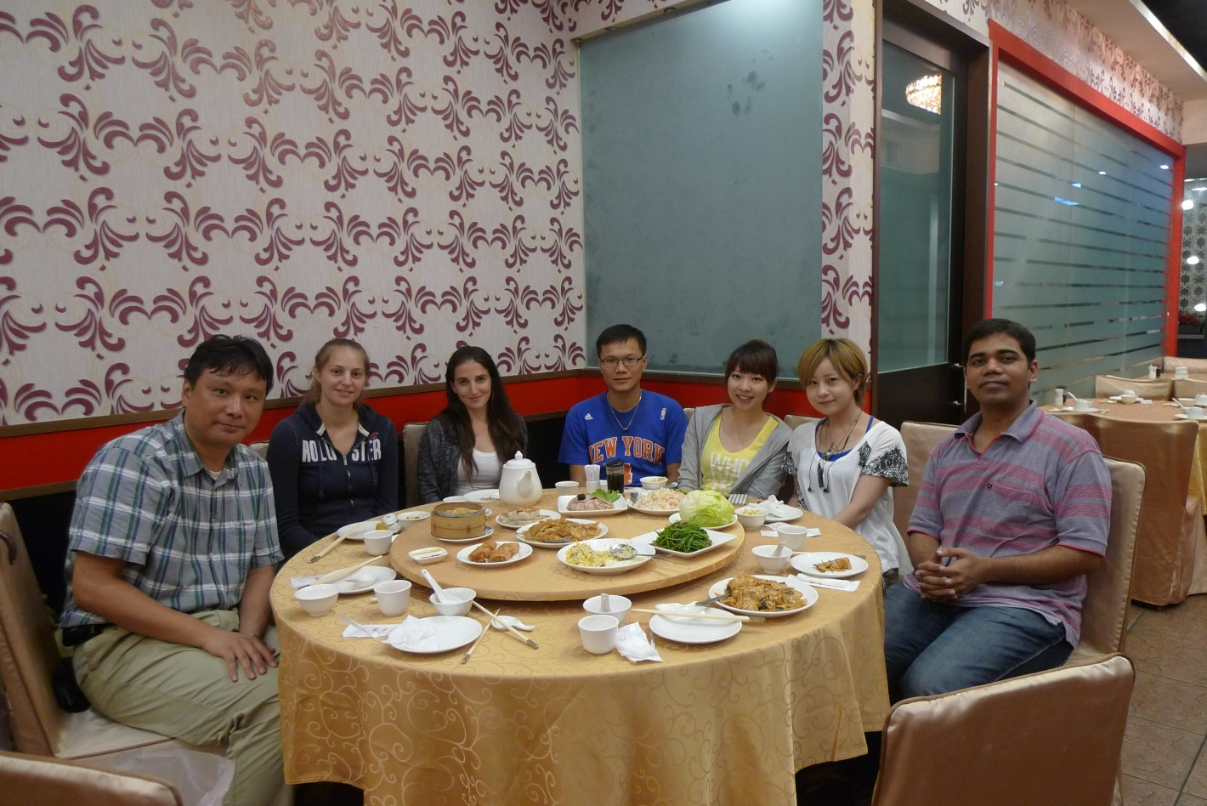
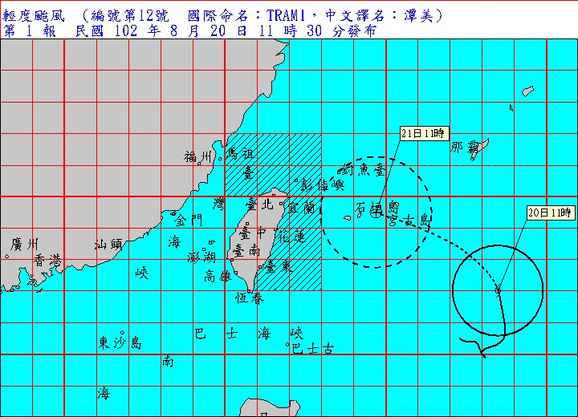
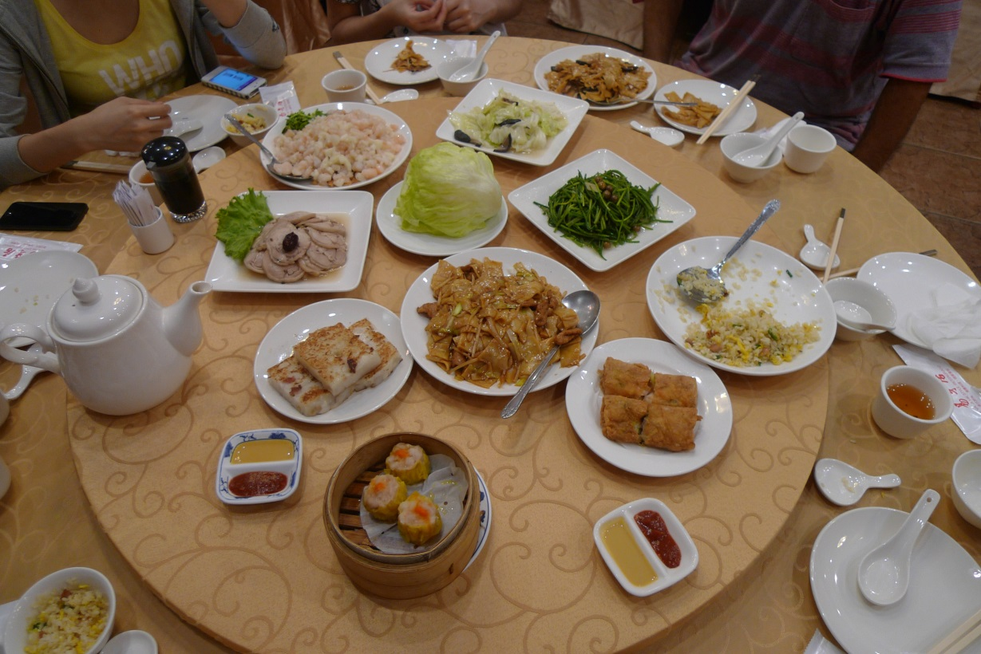
Cultural Fun

Slide 22
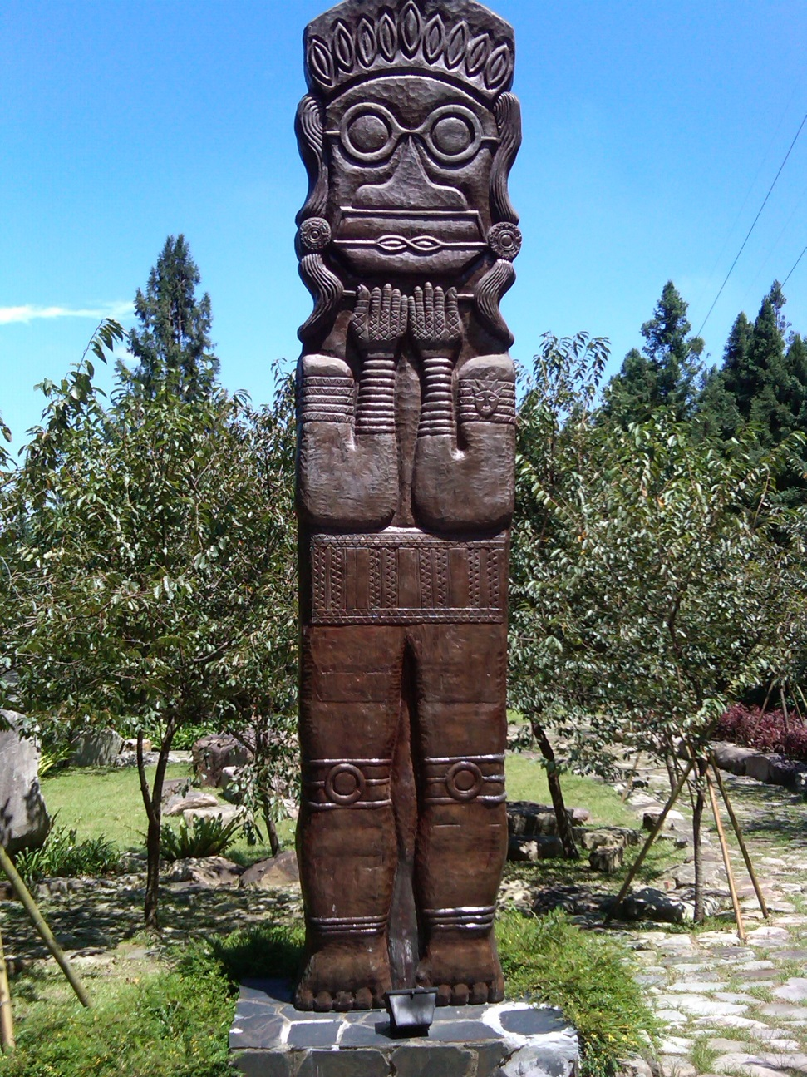

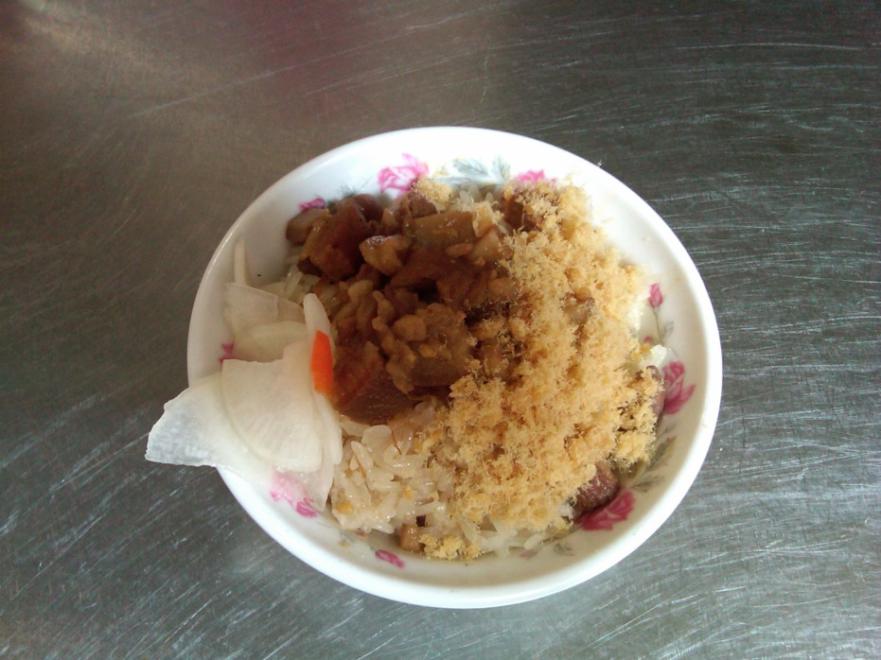
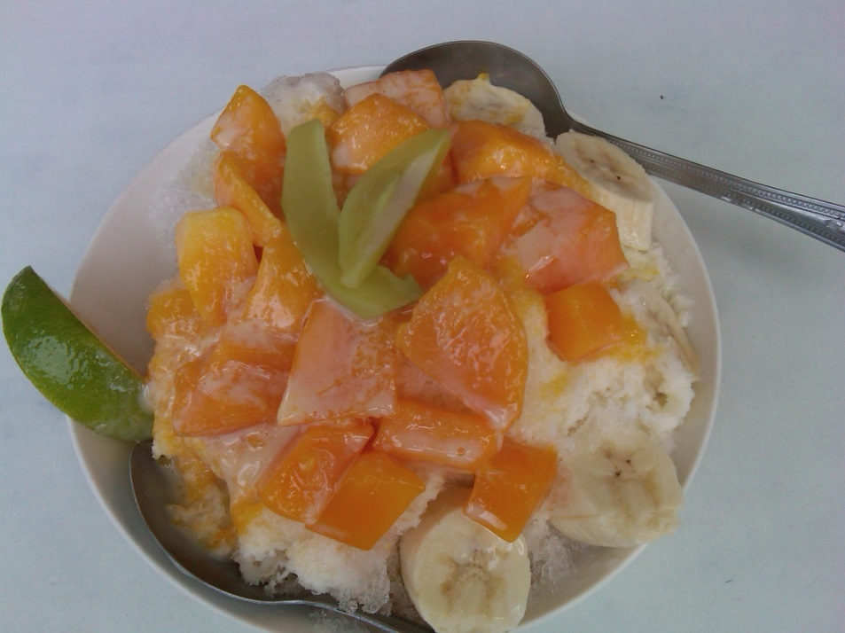
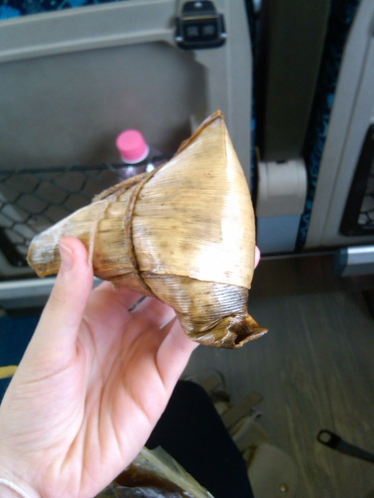
Wo ai Taiwan

Slide 23
I Would Like to Extend a Thanks to...
University of California, San Diego
Gabriele Wienhausen
Peter Arzberger
Dr. Phil Bourne
Chirag Krishna
National Taiwan University
Dr. Jung-Hsin Lin
Dr. Jung-Hsin Lin’s lab, and finally
Tosh Nomura Eureka! Foundation for making this trip possible

